Slide 1
Course : MOBI8001 – Mobile Technology and Cloud Computing
Green Mobile Cloud Computing
Session 07
D5727- Dr. Eng. Nico Surantha, ST., MT.

Slide 2
Reference
[1] DE, Debashis. Mobile cloud computing:architectures, algorithms and applications. CRC Press, 2016.
[2] A. Berl, E. Gelenbe, M. D. Girolamo, G. Giuliani, H. D. Meer, M. Q. Dang, and K. Pentikousis, Energy-efficient cloud computing, The Computer Journal, 53(7), 1045–1051, 2010.
[3] H. T. Dinh, C. Lee, D. Niyato, and P. Wang, A survey of mobile cloud computing: Architecture, applications, and approaches, Wireless Communications and Mobile Computing, 13(18), 1587–1611, 2013.

Slide 3
Outline
Introduction
Green Mobile Computing
Green Mobile Network
Green Cloud Computing
Green Mobile Cloud Computing
Green Mobile Devices Using Mobile Cloud Computing
Green Femtocell Using Mobile Cloud Computing
Green Seamless Service Provisioning with Mobile Cloud Computing
Green Location Sensing within Mobile Cloud Computing Environment
Conclusion
Bina Nusantara University

Slide 4
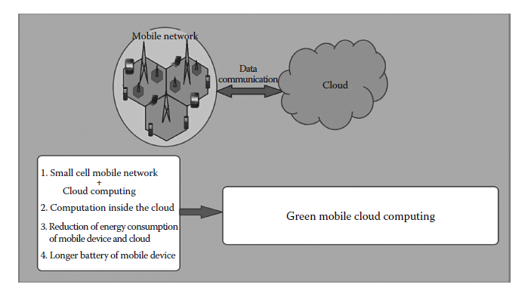
Introduction
Notes:
In this chapter, we discuss several existing approaches for green mobile networks and green cloud
computing. Based on comparative studies, we discuss how green mobile cloud computing
can be achieved by merging green cellular networks with the cloud environment.

Slide 5
Introduction (2)
Green mobile cloud computing is an emerging research area today.
Green mobile network means an energy-efficient mobile network that consumes low power.
By offloading computation inside the cloud, the power consumption by a mobile device can be reduced. But this can cause more power consumption and expense inside the cloud.
Thus, there should be a tradeoff between an energy-efficient mobile network and a green cloud environment.
In this chapter, we discuss several existing approaches for green mobile networks and green cloud computing.
Bina Nusantara University

Slide 6
Green Mobile Computing
Research in the field of mobile communication is focused currently on the advancement of greener mobile networks, that is, networks that consume low energy.
The rapid growth of energy consumption by the mobile devices poses a serious threat to biodiversity
A mobile network consists of the following five components, as shown in Figure 5.1:
  Data centers
  Macrocell base station (MBS)
  Femtocell base station (FBS)
  Mobile devices
  Mobile application and services

Slide 7
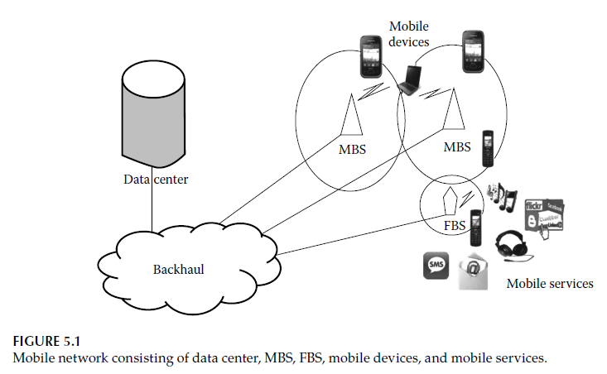
Green Mobile Computing (2)

Slide 8
Green Data Center
Currently, the number of data centers in the backhaul is constantly increasing with the growing surge of data storage and computations online.
In the interim, the energy consumption of the data center is increasing tremendously.
Some green techniques have been developed to reduce energy
  switching the on/off device, e.g. switch off inactive network device
  developing hardware and software in accordance with the traffic load and user demands [4].

Slide 9
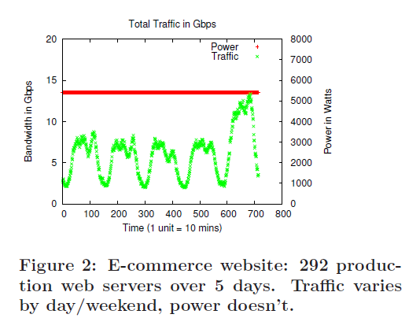
Green Data Center (2)
The total power consumed by networking elements in data centers in 2006 in the U.S. alone was 3 billion kWh and rising
Trace 1 (Figure 2) shows aggregate traffic collected from 292 servers hosting an e-commerce application over a 5 day period in April 2008
A clear diurnal pattern emerges; traffic peaks during the day and falls at night, but constant power
Reference: Heller, B., Seetharaman, S., Mahadevan, P., Yiakoumis, Y., Sharma, P., Banerjee, S., & McKeown, N. (2010, April). ElasticTree: Saving Energy in Data Center Networks. In Nsdi (Vol. 10, pp. 249-264).

Slide 10
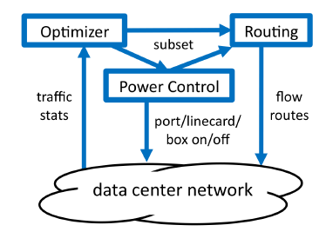
Green Data Center (2)
ElasticTree is a network-wide energy optimizer that continuously monitors data center traffic conditions.
It chooses the set of network elements that must stay active to meet performance and fault tolerance goals; then it powers down as many unneeded links and switches as possible.
The optimizer’s role is to find the minimumpower network subset which satisfies current traffic conditions.
Elastic tree approach
Reference: Heller, B., Seetharaman, S., Mahadevan, P., Yiakoumis, Y., Sharma, P., Banerjee, S., & McKeown, N. (2010, April). ElasticTree: Saving Energy in Data Center Networks. In Nsdi (Vol. 10, pp. 249-264).

Slide 11
Green Macrocell Base Station
Nearly 60% of the energy consumption of a mobile network is for operating the MBSs .
Moreover, as the MBSs are densely deployed for guaranteeing effective coverage, the cost of the required resources also increases.
Some green techniques have been proposed
  Some of the MBSs can remain switched off while others remain switched on and take care of the coverage at the time of low traffic . [Marsan, et al]
  Cell zooming strategy is implemented that effectively adjusts the cell size according to the traffic load, user requirements, and channel conditions. [Niu, et.al.]
  Cell breathing is another popular congestion control scheme, which also adjusts cell size depending on the traffic load [Mukherjee,et.al].

Slide 12
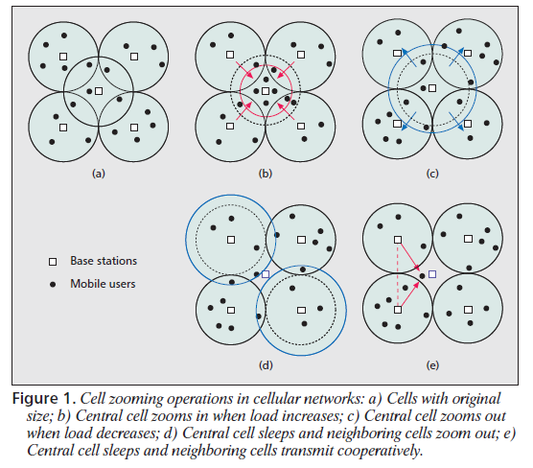
Green Macrocell Base Station (3)
References: Niu, Z., Wu, Y., Gong, J., & Yang, Z. (2010). Cell zooming for cost-efficient green cellular networks. IEEE communications magazine, 48(11).
Cell zooming operation
Notes:
When some MUs move into the central cell and make it congested, the central cell can zoom in to reduce the
cell size and therefore release from the congestion (Fig. 1b)
On the contrary, if some Mus move out of the central cell and cause the neighboring
cells congested, the neighboring cells can zoom in and the central cell zooms out to avoid any possible coverage hole
If the neighboring cells are designed to have high capacity, and therefore not necessarily zoom in, the central cell
can also choose to sleep to reduce the energy consumption.

Slide 13
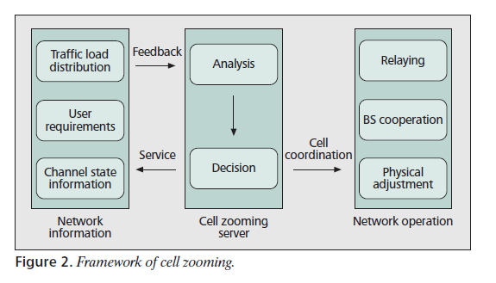
Green Macrocell Base Station (3)
References: Niu, Z., Wu, Y., Gong, J., & Yang, Z. (2010). Cell zooming for cost-efficient green cellular networks. IEEE communications magazine, 48(11).
Cell zooming operation
Notes:
When some MUs move into the central cell and make it congested, the central cell can zoom in to reduce the
cell size and therefore release from the congestion (Fig. 1b)
On the contrary, if some Mus move out of the central cell and cause the neighboring
cells congested, the neighboring cells can zoom in and the central cell zooms out to avoid any possible coverage hole
If the neighboring cells are designed to have high capacity, and therefore not necessarily zoom in, the central cell
can also choose to sleep to reduce the energy consumption.

Slide 14
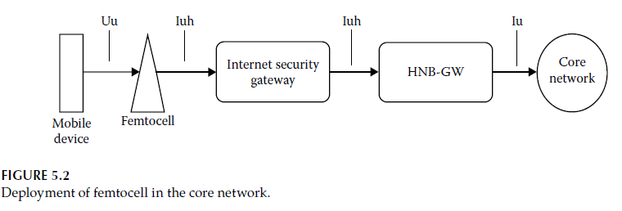
Green Femtocell Base Station
FBSs are low-cost, low-power, self-deployed base stations that are used effectively for the reduction of energy consumption of mobile networks.
Though each femtocell is a low-power device, when a number of femtocells operate together, the energy consumption is quite large. Thus, reduction of energy consumption is necessary at this sector too.

Slide 15
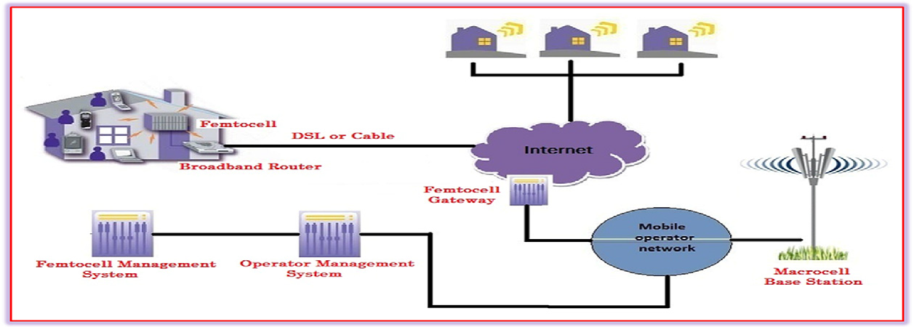
Green Femtocell Base Station

Slide 16
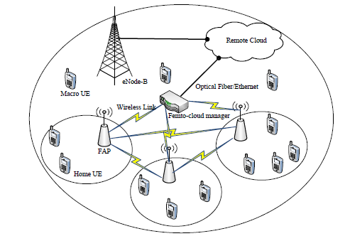
Green Femtocell Base Station
Femto-cloud architecture

Slide 17
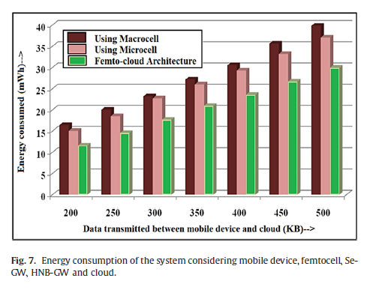
Green Femtocell Base Station
Reference: Mukherjee, A., & De, D. (2016). Low power offloading strategy for femto-cloud mobile network. Engineering Science and Technology, an International Journal, 19(1), 260-270.

Slide 18
Green Femtocell Base Station (2)
Some green techniques have been developed as follow:
  Yeh et al. observed that energy control is of utmost importance between coverage and performance for greening the femtocell.
  Adaptive coverage based on outdoor and indoor user mobility is proposed by Claussen et al.
  Ashraf et al. propose an algorithm to improve the energy efficiency of femtocell base stations as per user activity detection.

Slide 19
Green Femtocell Base Station (2)
Some green techniques have been developed as follow:
  Yeh et al. observed that energy control is of utmost importance between coverage and performance for greening the femtocell.
  Adaptive coverage based on outdoor and indoor user mobility is proposed by Claussen et al.
  Ashraf et al. propose an algorithm to improve the energy efficiency of femtocell base stations as per user activity detection.

Slide 20
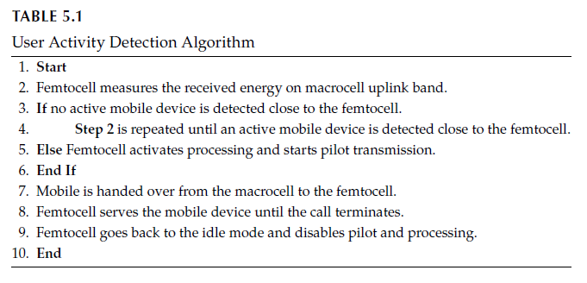
Green Femtocell Base Station (3)
Notes:
Ashraf et al. [13] propose an algorithm to improve the energy efficiency
of femtocell base stations as per user activity detection. According to the proposed
algorithm, the femtocell switches off its transmission and the associated processing in the
absence of active users.
A low-energy sniffer capability is included in the femtocell base
station that detects any active call from a mobile to the underlying macrocell [13].
Once an active call is detected from a registered mobile device by the sniffer, the femtocell can
reactivate the air interface and its pilot energy transmission, which means that it enters the
active mode.
On switching to the active mode, the mobile reports the femtocell pilot to
the macrocell to which it is connected, and the mobile is handed over from the macrocell
to the femtocell.
The user activity detection algorithm is presented in Table 5.1 [13].

Slide 21
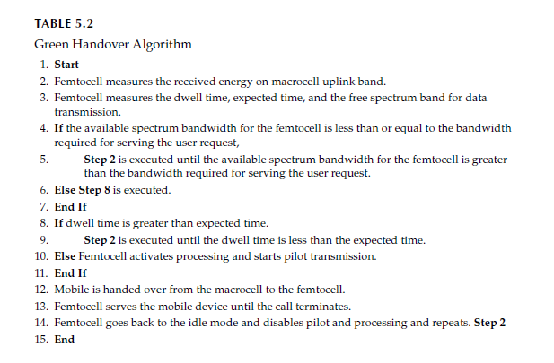
Green Femtocell Base Station (4)
Notes:
A femtocell is in active mode if it has multiple connected mobile devices with it. When a
femtocell is not in active mode, it can switch off its energy amplifier, RF transmitter, RF
receiver, and other hardware performing functions such as data encryption and hardware
authentication.
It has been proved that the energy consumption of an active femtocell is
10.2 W and that of an idle femtocell is 6 W [13,14]. Thus, when a femtocell is switched off,
there is a saving of its processing energy by 4 W. An energy-efficient handover scheme is
proposed in Table 5.2 [14].

Slide 22
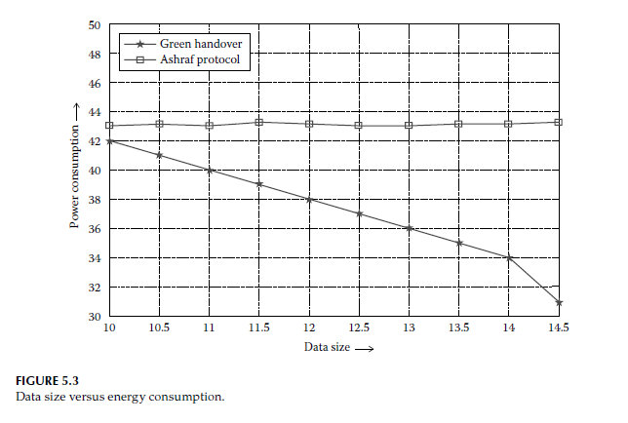
Green Femtocell Base Station (5)

Slide 23
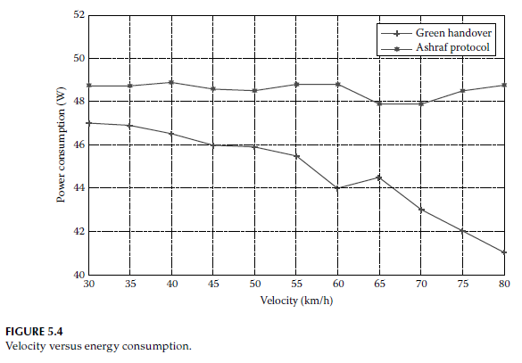
Green Femtocell Base Station (6)

Slide 24
Green Femtocell Base Station (7)

Slide 25
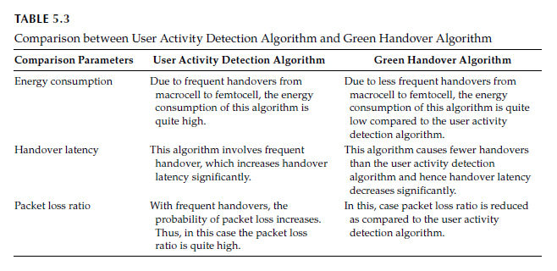
Green Femtocell Base Station (8)

Slide 26
Green Mobile Device
The fast development of mobile devices and the increasing demand for high computational energy is a matter of concern for green mobile networks.
Green techniques are implemented in mobile devices considering the energy demand, resource needs, traffic pattern, and user behavior.
A dynamic resource allocation scheme based on user requirement prevents unnecessary resource and energy wastage designed for mobile devices .
The implementation of these techniques results in green mobile devices and thus green mobile networks.

Slide 27
Green Mobile Application and Services
The key goal of mobile networks is to offer satisfactory services to mobile users.
Different techniques for green applications have been discussed :
  Lu et al. proposed an approach for reducing energy consumption of mobile applications and services by using data compression to reduce the size of the data being transmitted by eliminating redundant data.
  Energy saving in VoIP service is proposed in Baset et al. The proposed technique includes the use of persistent TCP connection, which results in fewer keep-alive message exchanges between devices in the network, thus resulting in less energy consumption.

Slide 28
Conclusion
Offloading involves power consumption in executing an application and during communication with the remote cloud.
To better utilize the resource on the cloud, there is a trade-off between transmission energy cost and local execution energy cost.
Though many works have made an effort to find the balance point, only a subset of those studies focuses on energy efficiency, while in many cases they merely focus on response time and other resource consumption.
A large part of the researches uses modeling and simulation. Some of the models only offload parts of the program to the server, which reduces transmission cost, while at the same time bringing extra partition overhead.
Other works have focused on transplanting the entire OS or application runtime to the cloud as this ease the burden on external application programmers.

